Slide 1
Black and White Photography
First 5 pictures

Slide 2
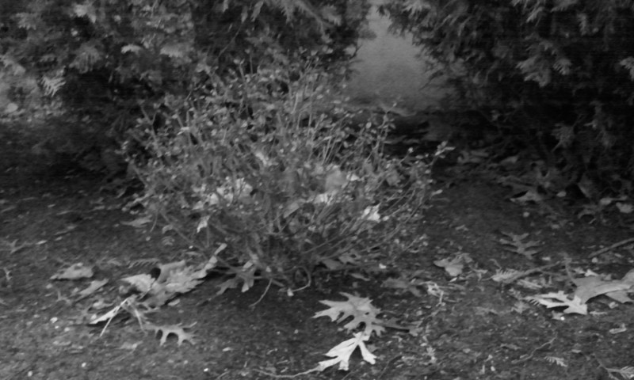
Theme: outside the house This picture was taken in my moms garden The time of day was 4:30 The thing that attracted me to take this picture was it looked so beautiful

Slide 3
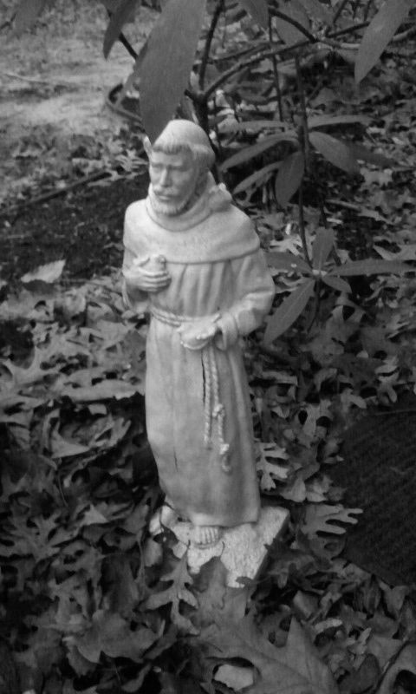
Theme: outside the house The picture was taken in my moms garden. The picture was taken around 4:30 This picture attracted me because I wanted to see what it would look like in black and white

Slide 4
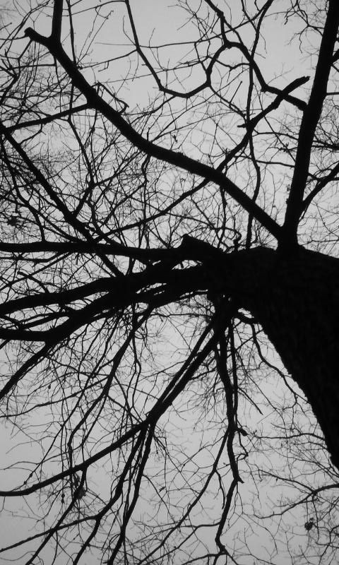
Theme: outside the house
This picture was taken in my backyard
The time of day was 4:45
I was attracted to this picture because it looked cool.

Slide 5
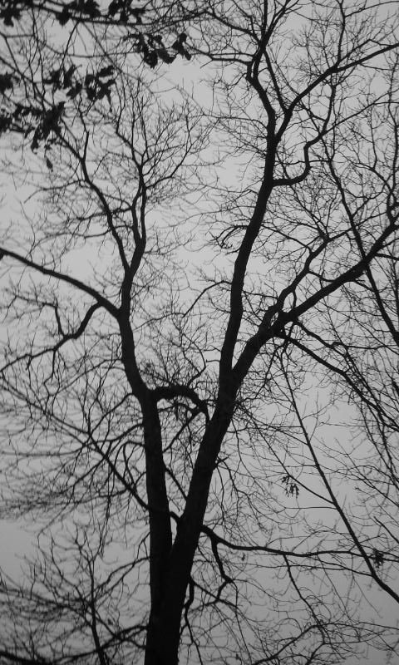
Theme: Outside the house
This was taken in my backyard
It was taken around 4:45
I was attracted to this picture because I wanted to see what it looked like from the other angle

Slide 6
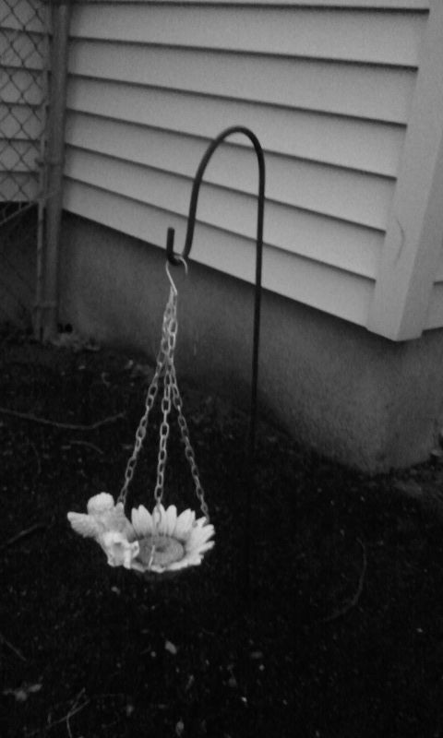
Theme: outside the house This was taking in the front of my house This picture was taken around 4:46

